Slide 1
RFID in Jewellery Management System

Slide 2
Inventory Procedures Jewellers
Jewellery is one of the most valuable assets that people process. A jewellery company faces a tremendous task of maintaining, and accounting for tens of thousands of jewellery items in a single store. Most of the jewellers track inventory on daily or weekly basis. This is often a completely manual process, which requires handling of each jewellery item separately, and is therefore, very time consuming and prone to errors. In a premium business such as this, even a small error or loss can be significantly expensive. Huge amounts can be lost due to inefficient and slow inventory tracking

Slide 3
Issues faced by Jewellery Company
Tracking and monitoring of precious jewellery items, boxes or pouches is difficult.
Since many jewellery displays are set up daily and then stored in safes in the evenings, there is opportunity for Threat of theft or loss of product. Weak security
Time consuming inventory checking.
Huge requirement of manual power.
Difficult to manage information related to the Jewellery items.
In-effective contemporary technologies.
Due to the fluctuation in jewellery value as the price of gold fluctuates; the insurance costs of inventory can vary. It is critical to maintain accurate inventory in order to maintain accurate insurance records.

Slide 4
The Philosophy / Benefit of RFID
Faster and more accurate inventory management
Constant update of information on real-time of each item in the inventory
Greater security for valuable items
Diligent individual monitoring of each item
Increase in staff efficiency
Facilitates billing
Better traceability of multiple articles
Fast invoicing at the counters and less waiting lines
Detailed reports

Slide 5
What Stallion Provides in the field of RFID
Best in class RFID Hardware.
Easy to use RFID middleware software.
Integration capability with existing ERP or Billing Software.
High quality consumables.
Dedicated Customer Support.
Consulting based approach.
Architecture of the solution as per customer need.
Better traceability of multiple articles.
Detailed reports / dashboard as per need.

Slide 6
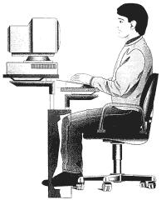
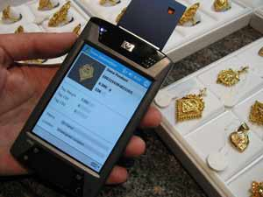
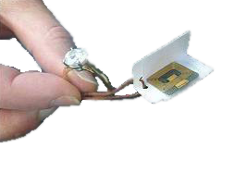
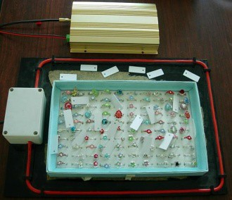
Work flow of Jewellery Management System
Jewellery
Application Server
With Jewellery database
Hand Held UHF Reaer
RFID enable Tray
Metal Tag attached to jewellery

Slide 7
Software
Product Master / Catalogue Master
Stock Audit
Tag Writing
Data Upload
Item Search
Customised Dash Board / Smart View

Slide 8
Item Master
100% Accuracy
Over the glass counter scanning
Super fast scan speed
Catalog generation /RFID search of missing items.
Selective scanning based on counter, box, item type, collection etc.
Centralized Reporting.

Slide 9
RFID Tag Write
RFID tag can be written with a Unique number.
All other detail will be stored at the back end.
Each Tag can be written multiple times depending on the requirement.

Slide 10
Customized Dashboard
Centralize reporting tool.
Item wise Dash Board.
Date wise dashboard.
Total Item Count.
Facilitate informed business decision based on graphs and charts.

Slide 11
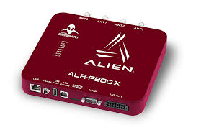
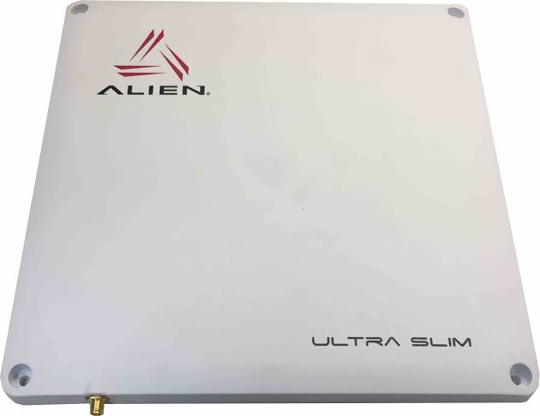
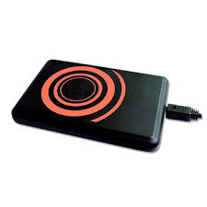
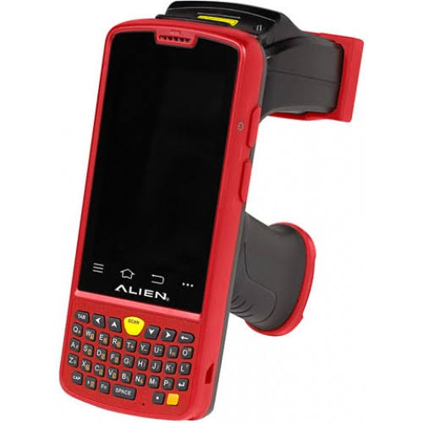
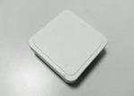
Suggested Items
Sr. No. | Items | Picture | Remarks
01 | 4 PORT RFID UHF reader |  | RFID UHF reader reading Tag data.
03 | RFID ANTENA |  | RFID antenna attached with reader can help to read the tags.
04 | Desktop USB RFID UHF reader |  | For Tag writing purpose and short distance reading.
05 | RFID Handheld UHF reader with barcode or without barcode. |  | RFID mobile Terminal for writing and reading and stock checking & searching missing items.
06 | Desk top reader |  | This can be used at billing counters.
07 | Hard Metal Tag (22*8 MM) |  | This is hard metal tag with hole at both end.

Slide 12
Thank You
THANK Y
THANK Y
THANK

